Slide 1
Drug Overdose Deaths
ASRM 595 Deep Learning For Finance and Insurance
Akshat Bhardwaj, Catherine Li, Hélène Rondey, Yang-Hsuan Huang
Github

Slide 2
Why Predicting Overdose Deaths?
Plague-crisis: Over 107,000 drug related deaths were reported in the United States between 2020 and 2021.
A better method to predict future drug overdose deaths?
Help improve the development of related laws and policies
Help non-profit organizations allocate their resources properly.
Yang-Hsuan Huang

Slide 3
Introduction
Data: US Provisional Drug Overdose Death(OD) Counts
Range: Jan 2015 ~ Sep 2023
Sample: 60,000
Label: Predicted OD Count per state (OD Count are often incomplete and causes of death may be pending investigation)
Features: Month, Indicator(drug types), State, Percent Pending Investigation
*Not considering Weather/Season due to the insensitivity to variations by seasonality in this dataset
Yang-Hsuan Huang

Slide 4
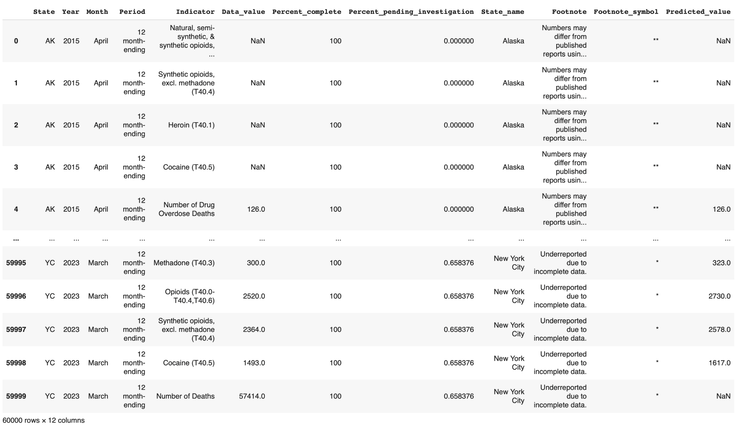
Sample Data
Provisional Drug Overdose Death Data
Catherine Li

Slide 5
Data Extraction
Dataset: 60,000 rows, 12 columns
Preprocessing steps:
Renaming columns
Convert dtypes
Defining debug and working datasets
10,000 for debug
60,000 for working
Catherine Li

Slide 6
Data Exploration
Remove unnecessary features (i.e., Footnote, Footnote_symbol).
Remove all overlapping classes under variables ‘State’ and ‘Indicator’ (eg. ‘US’).
Construct df1: table of drug overdose deaths to observe the trends.
Construct df2: table of drug overdose deaths and death rate per state.
Observe overdose deaths through drug types (Cocaine, Heroine, Methadone, etc.) by looking at trends and distributions.
The difference between reported data and predicted data is slight but growing.
Catherine Li

Slide 7
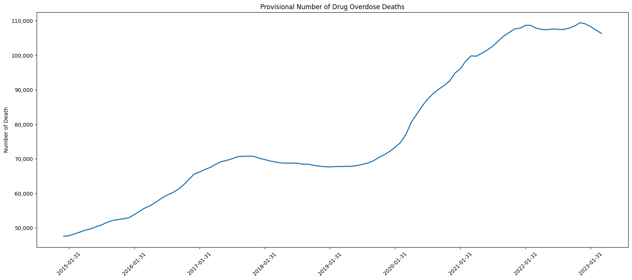
Data Exploration - Trends of Overdose Deaths
Catherine Li

Slide 8
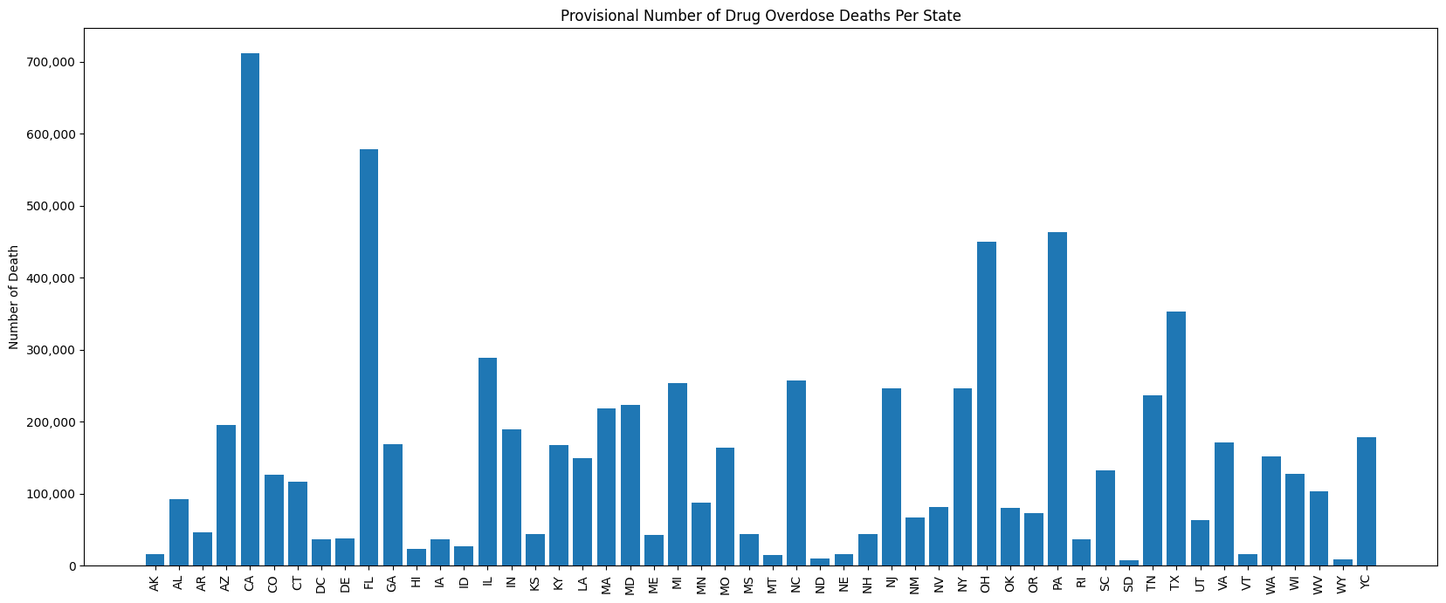
Data Exploration - Overdose Deaths Per State
Catherine Li

Slide 9
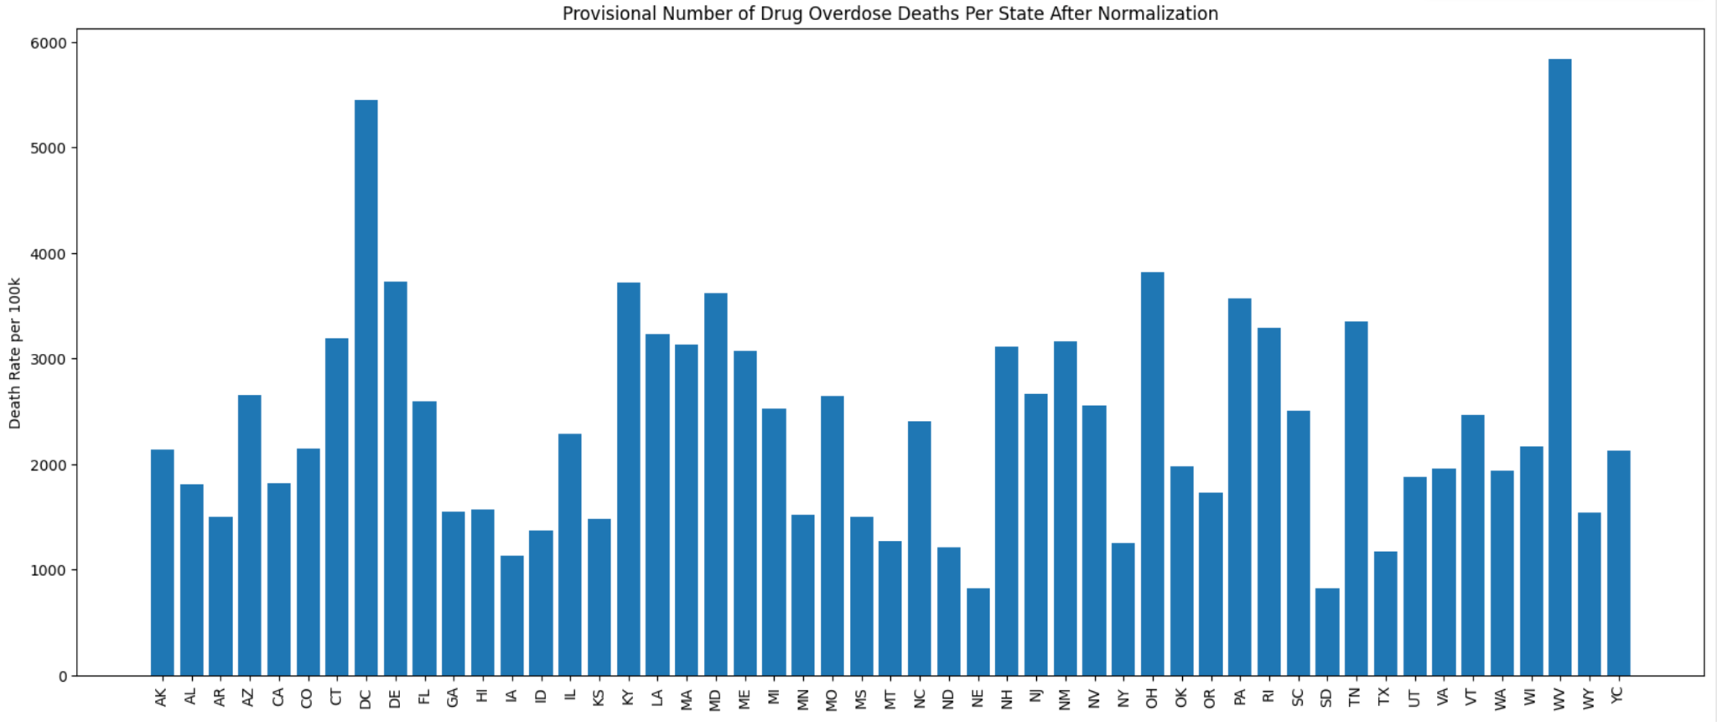
Data Exploration - Death Rate Per State
Catherine Li

Slide 10
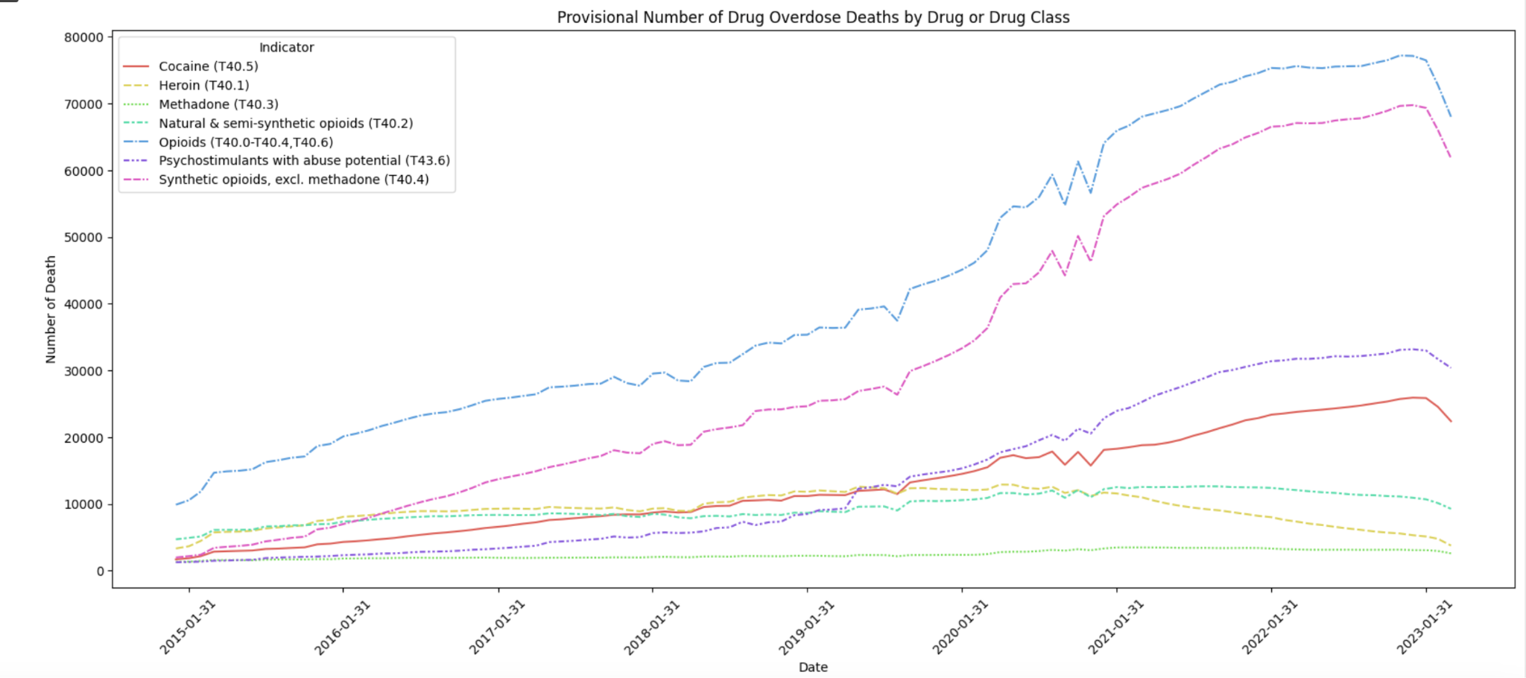
Data Exploration - Drug Types (Trends)
Catherine Li

Slide 11
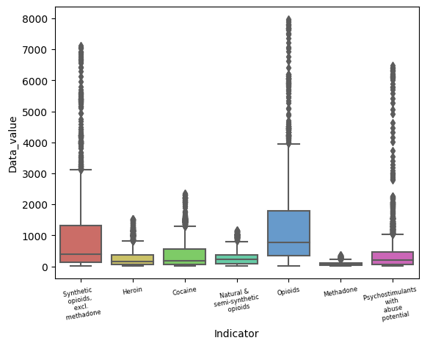
Data Exploration - Drug Types (Boxplot)
Among the seven types of drugs, those related to opioids account for a significantly higher number of deaths.
Catherine Li, Yang-Hsuan Huang

Slide 12
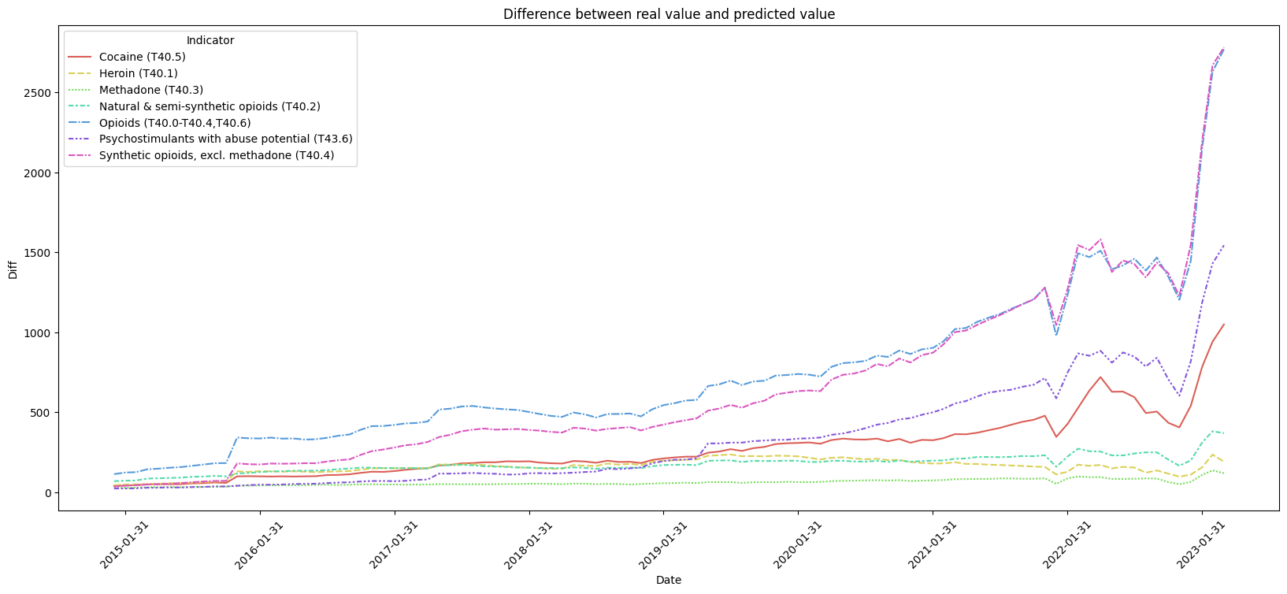
Data Exploration - Difference Between Values
Catherine Li

Slide 13
Base Learning - Preprocess
Drop OD Count because it is an underestimation of the actual death counts, and Predicted OD Count is built on it (high correlation), leading to overfitting and neglecting the other variables’ predictive power.
Convert categorical variables (i.e., State, Month) into binary variables (one-hot encoding) and dtypes(float32)
State LA, ND, NE, PA do not have records in the datasets, so they are not considered in this case.
Akshat Bhardwaj, Yang-Hsuan Huang

Slide 14
Base Learning - Ridge Regression
Firstly, we want to regularize the features as a simple linear regression model tends to overfit the data, and Lasso has a tendency to set the coefficients of many features to zero.
For categorical features we do not want to have features with exact zero coefficients, instead we want to know how much do each of them contribute relative to others.
Thus, using Ridge regression here makes sense.
Akshat Bhardwaj, Yang-Hsuan Huang

Slide 15
Base Learning - Prediction Result
Based on Ridge regression, the prediction results compared with the predicted value are:
Mean: 494 deaths
Mean Absolute Error: 333 deaths
Standard deviation: 505 deaths
The results are not very optimal, and also there are negative prediction values appearing in the results, which we will try to solve during the deep learning process.
Akshat Bhardwaj, Yang-Hsuan Huang

Slide 16
Deep Learning - Architecture
Architecture Overview:
Feed Forward Neural Network.
Input layer: 69 nodes (i.e. we have 69 features)
Hidden layers: 3 layers with 128 nodes each, using Tanh activation
Output layer: Single node with ReLU activation for number of death
Akshat Bhardwaj, Hélène Rondey

Slide 17
Deep Learning - Training
3 Optimizers: Adam, RMSprop, Stochastic Gradient Descent (SGD)
Loss Function: Utilizes Mean Squared Error Loss (MSELoss) for training accuracy.
Using a Grid Search to find the best combination of hyperparameters with each optimizer, performing 4-fold Cross-validation
Metric to assess the out-of-fold performance and select the best hyperparameters: Mean Absolute Error
Akshat Bhardwaj, Hélène Rondey

Slide 18
Deep Learning - Model Selection
Hyperparameter Tuning:
Learning rates, Momentum, and Epsilon
Each model variant trained for 10 epochs
Batch Size: 64, 128, 256, 512
Performance Insights: A smaller learning rate is better
Best Performance: Adam optimizer with Learning Rate 0.001, Epsilon 1e-08, get MAE = 0.00778
Akshat Bhardwaj, Hélène Rondey

Slide 19
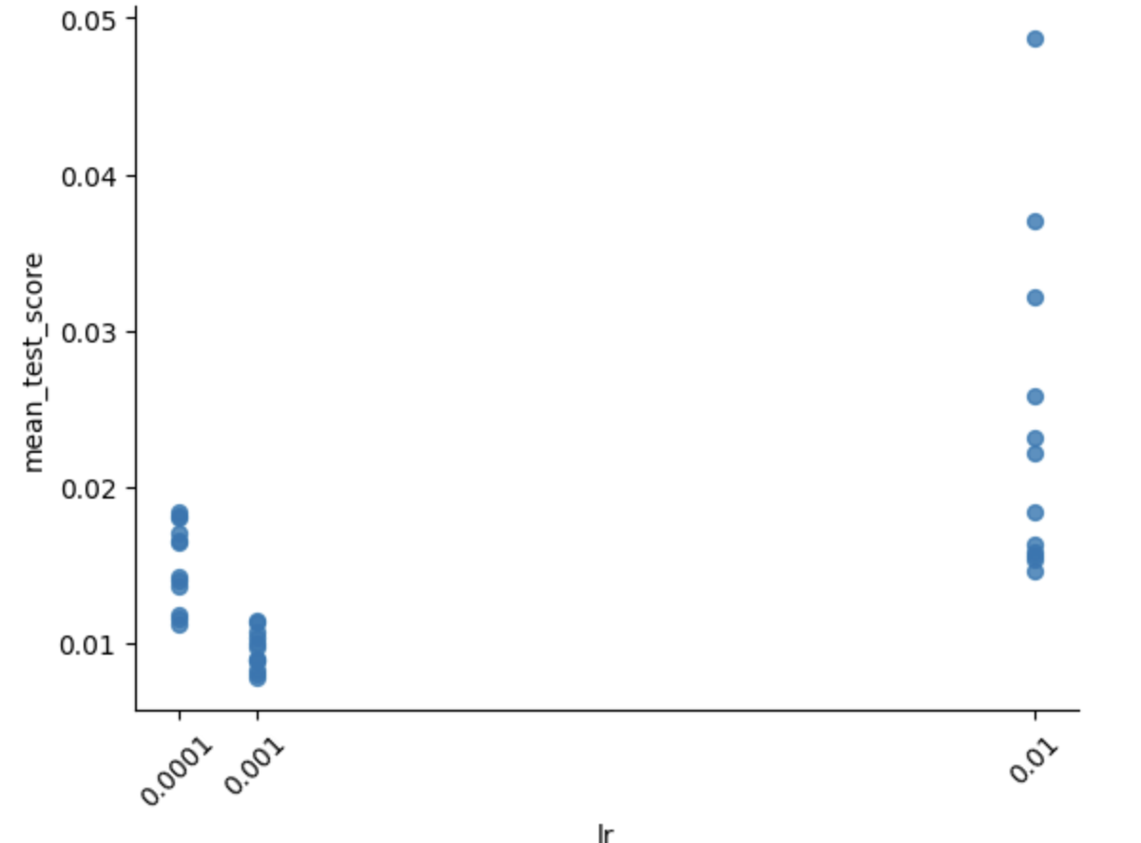
Deep Learning - Test Score for each LR
Optimal Learning Rate: The learning rate of 0.001 yields the most consistent performance.
Variability : at 0.01, the performance seem quite variant, indicating the LR may be too high.
Hélène Rondey, Catherine Li, Akshat Bhardwaj

Slide 20
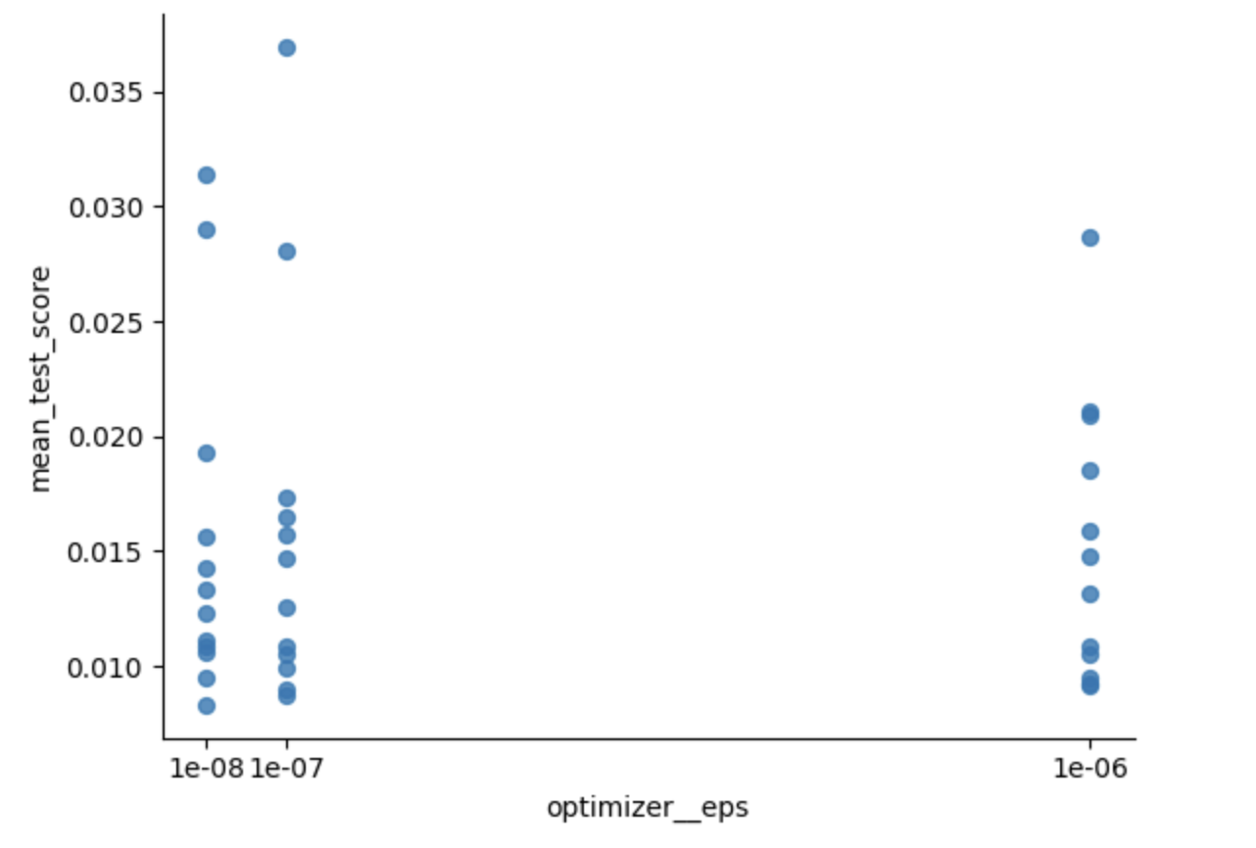
Deep Learning - Test Score for each Epsilon
The epsilon value of 1e-08 yields marginally better model performance compared to the larger epsilon values.
There is an increased variability in test scores as the epsilon value increases.
Akshat Bhardwaj, Hélène Rondey

Slide 21
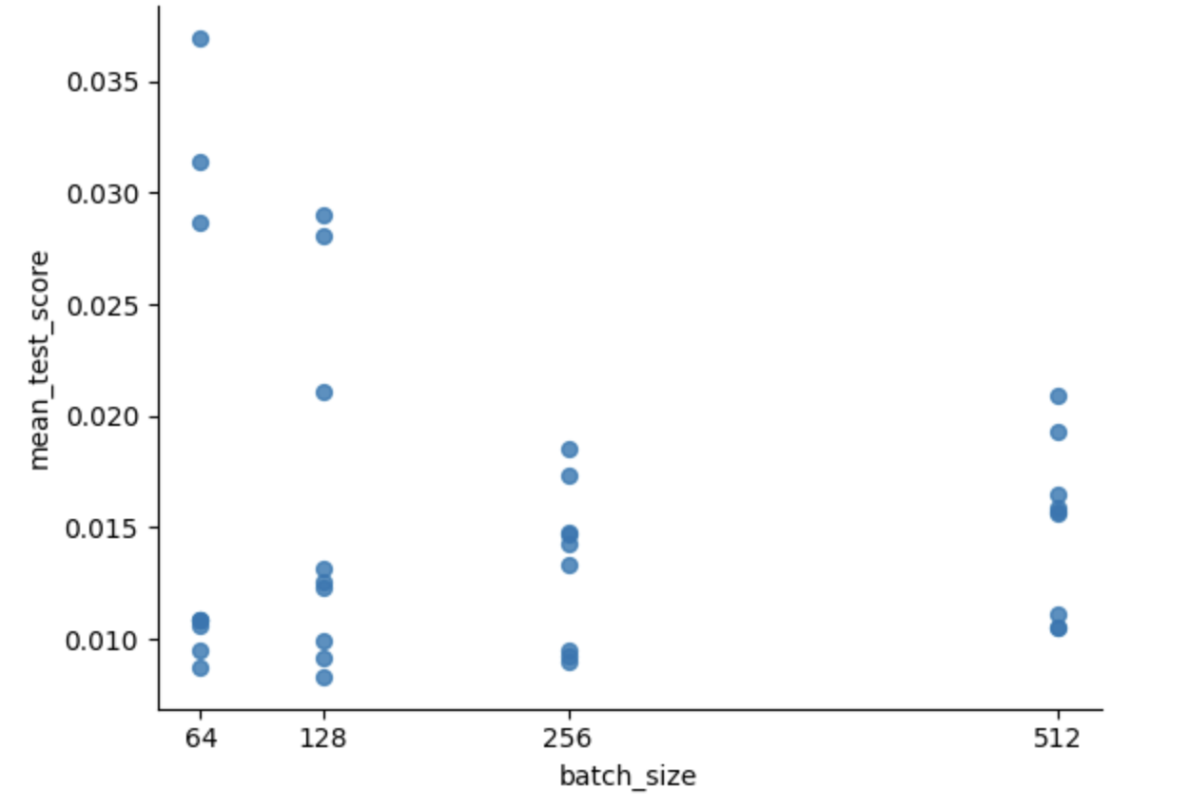
Deep Learning - Test Score for each Batch size
Using batch sizes of 256 and 512 leads to more consistent and better performance compared to smaller batch sizes, although one iteration of size 128 has led to the best performance out of all.
Akshat Bhardwaj, Hélène Rondey

Slide 22
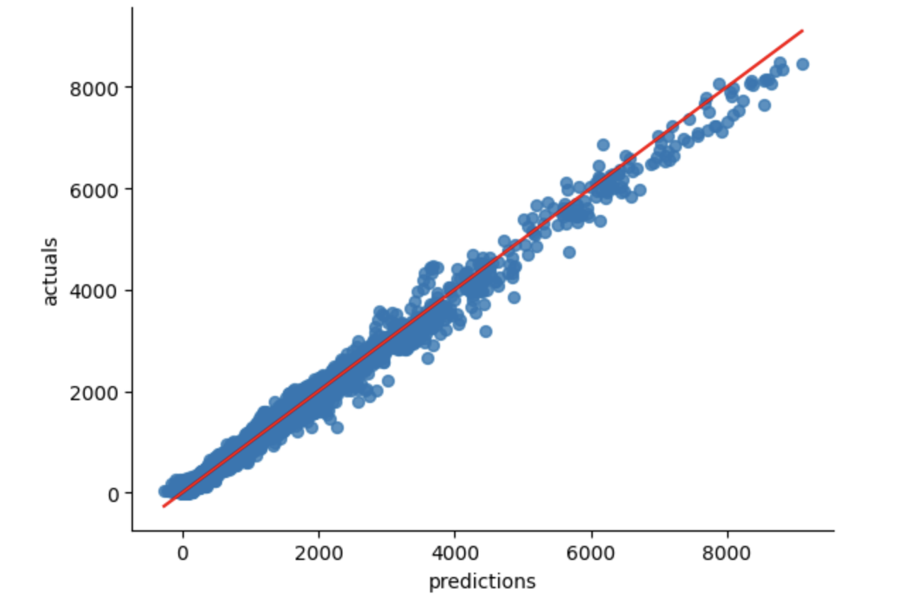
Deep Learning - Train Performance
The model seems to be biased and has a tendency to underestimate the number of deaths at higher values points.
This suggests that the model has room for improvement to capture trends in this range of death counts values.
Mean Absolute Error (rescaled data) : 51.84
Fairly good metric considering the range of values
Hélène Rondey, Catherine Li

Slide 23
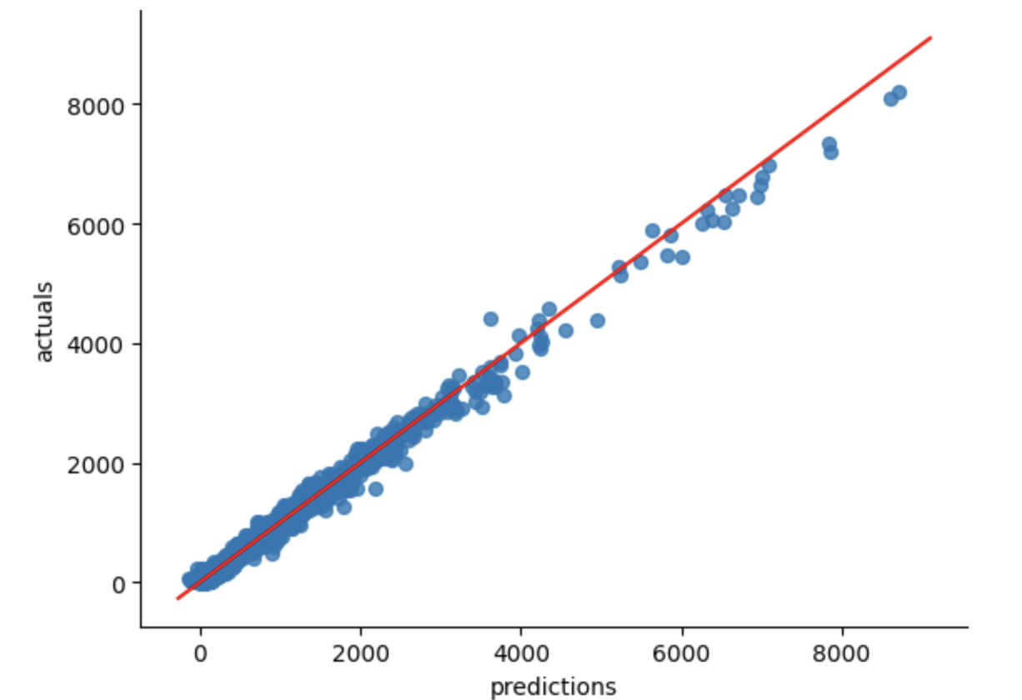
Deep Learning - Test Performance
The quality of predictions is fairly good and is similar to performance on the training set : no under or over-fitting
There is the same bias for the very high values.
Mean Absolute Error (rescaled data) : 53.41
Hélène Rondey, Catherine Li

Slide 24
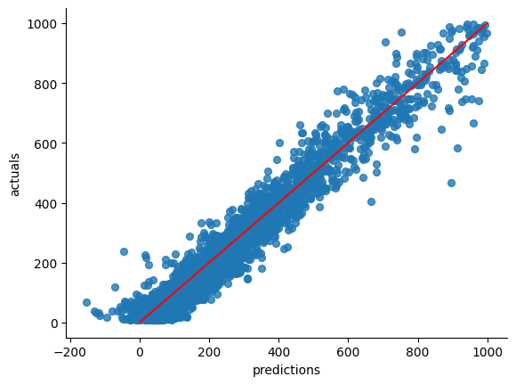
Deep Learning - Test Performance (smaller values)
The overall Relative Error is quite high, but after separating small and high values of death counts, we discover the relative error is high for the smaller death counts.
There is room for improvement too for smaller values.
Mean Relative Error on the test set :
48%
MRE for values under 1000 deaths : 55%
MRE for values above 1000 deaths : 6%
Training set: 45%, 52%, 6% resp.
Hélène Rondey

Slide 25
Feature Importance
SHAP values (SHapley Additive exPlanations) is a method used to facilitate the interpretability of models:
It provides the individual contribution of each feature on the output of the model, for each observation.
Summing the effects allows to assess the total impact of each feature
The original article can be found here: A Unified Approach to Interpreting Model Predictions ; Lee & Lundberg, NIPS (2017)
Hélène Rondey

Slide 26
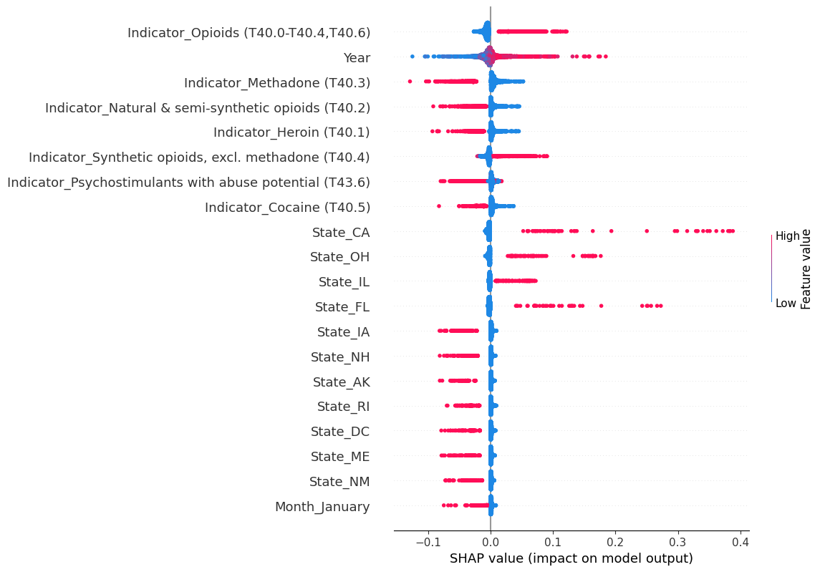
Feature Importance - Contribution of Features
The indicators for Opioids and Synthetic Opioids mostly have a positive effect on the prediction, as well as the indicators for the states of California, Ohio, Florida and Illinois. The other drug types seem to have a negative impact on the predictions.
This matches to our observations from the Data Exploration.
Hélène Rondey

Slide 27
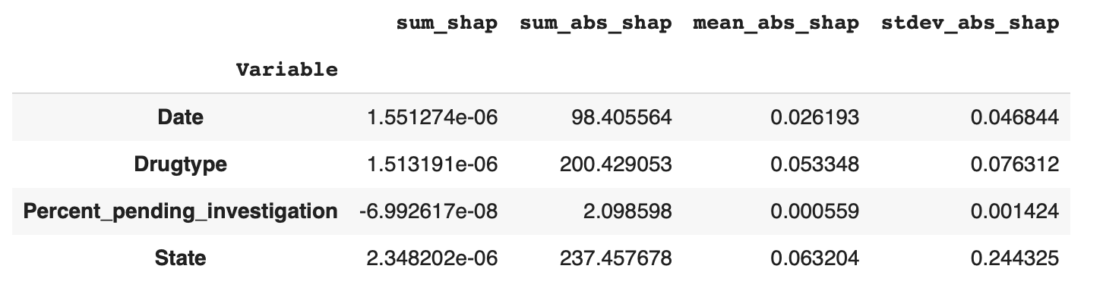
Feature Importance - Absolute Effect of Variables
State has the biggest impact in the prediction, followed by the drug type, and then the date. Small impact of the percent of pending investigation indicated that delayed reports barely influences prediction.
Hélène Rondey, Yang-Hsuan Huang

Slide 28
Conclusion
Linear model was too poor because the large MAE (333 deaths,⅔ of the mean prediction) and negative prediction values.
We successfully predict with an MAE of 53 deaths.
The model exhibits a bias towards higher values, suggesting that it may underestimate in certain scenarios, while smaller values have a higher relative error.
But Feature Importance matches trends observed in Exploration, and the train and test errors are similar, so overall a fair part of the signal has been captured.
4 states (LA, ND, NE, PA) were not included in the training due the absence of data
Hélène Rondey, Yang-Hsuan Huang, Akshat Bhardwaj

Slide 29
Challenges & Lessons
Lessons:
Taking the time to understand how the features were built and how the data was collected to make sound decisions
Mastering notions of batch size, epochs, k-folds & estimator variance and bias
Coding challenges:
Learning how to mix the Sklearn (Grid Search) and Pytorch (Neural Net architectures) in the Skorch environment
Properly saving the optimal parameters and models
Hélène Rondey

Slide 30
FIN

